Slide 1
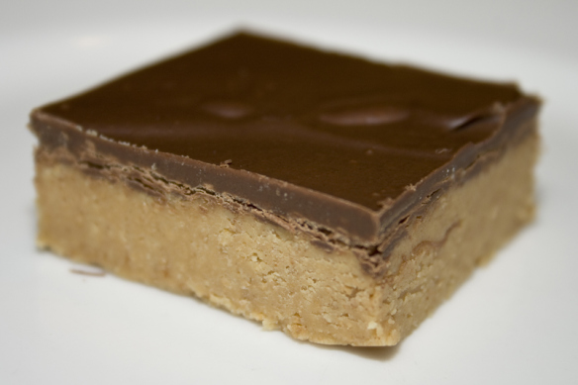
A little (or big) slice of heaven by Mrs. Hemer
Mybakerlady.com

Slide 2
thecraftyhostess.com

Slide 3
hdwallpaperspk.com

Slide 4
clevescene.com

Slide 5
malangue.org

Slide 6
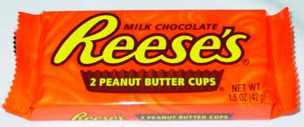
The Reese’s Peanut Butter Cup!
Commons.wikimedia.org
jacksoncompassionclub.com

Slide 7
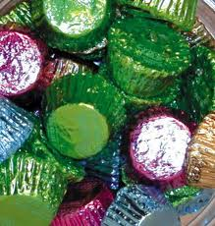
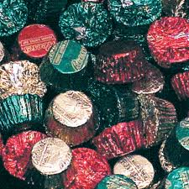
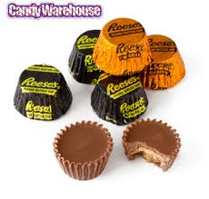
Easter
Christmas
metrocandy.com
metrocandy.com
candywarehouse.com
Halloween

Slide 8
Commons.wikimedia.org
jacksoncompassionclub.com

Slide 9
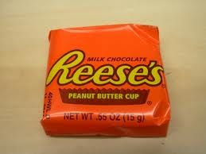
Cocoa-heaven.com
Commons.wikimedia.org
Johnnyscreepshow.blogspot.com

Slide 10
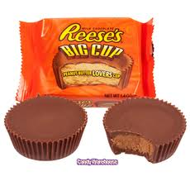
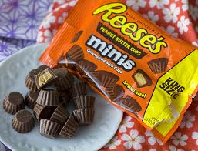
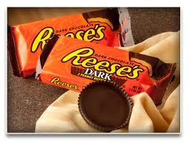
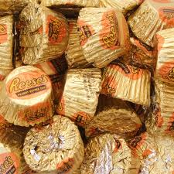
Blogs.babble.com
Candywarehouse.com
Beingjewishinhawaii.com
Thethriftycouple.com

Slide 11
DRESS like one!
Kaboodle.com
Family.go.com

Slide 12
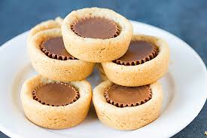
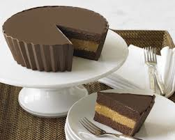
browneyedbaker.com
Twopeasandtheirpod.com
YUM!
Blogs.ocweekly.com

Slide 13
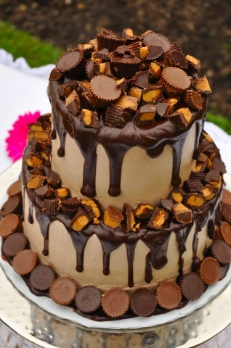
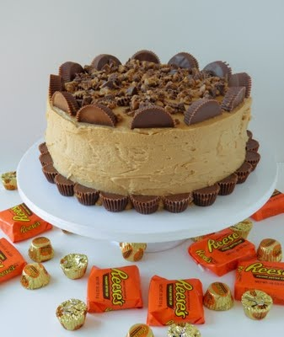
Theinternetchef.biz
Pincookie.com

Slide 14
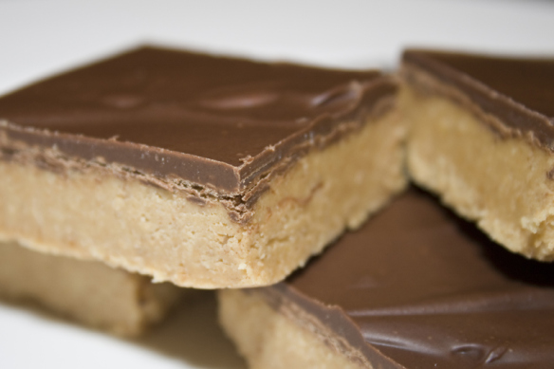
Mybakerlady.com

